Slide 1

ADVANCED ATTENDANCE TRACKING THROUGH FACIAL RECOGNITION TECHNOLOGY
REVIEW 1

Slide 2
PROJECT MADE BY
ADVANCED ATTENDANCE TRACKING THROUGH FACIAL RECOGNITION TECHNOLOGY
Name : Pranav Sanjay manapure
Register No. : 23MCA1041
GUIDE NAME
Dr. N. Prem Sankar
Assistant professor Senior Grade 1
School of Computer Science and Engineering
PMCA698J Internship I/Dissertation I

Slide 3
Abstract
Face recognition technology is used in smart attendance monitoring systems to automatically identify and confirm people so that their attendance can be monitored.
Students or employees can just stroll in front of a camera to have their attendance recorded without having to carry any specific cards or gadgets.
This review's major goal is to provide insight into a model based on three factors: dataset used for training, algorithm used for implementing the model and basic architecture of project.

Slide 4
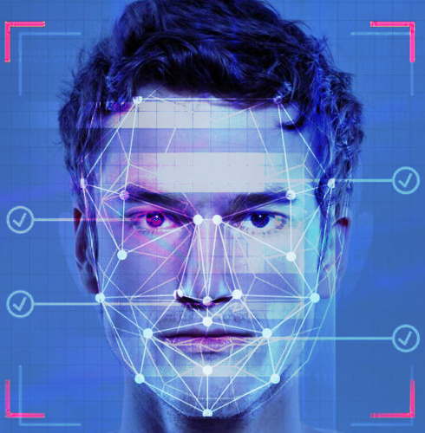
Introduction
Face recognition, often abbreviated as FR, is a cutting edge technology that has revolutionized the way we identify and authenticate individuals.
It harnesses the power of computer vision and machine learning to analyse and interpret the unique features of a person's face.

Slide 5
Overview
Problem statement
Research Objectives Identified
Datasets
Modules Identified
Architecture Diagram of Project
Literature review on the topic Identified (Minimum 10 Papers )
Guides Approval Mail screenshot
Status of work to be completed (Timeline)
School of Computer Science and Engineering
PMCA698J Internship I/Dissertation I
Notes:
5. Proposed Solution to the Problem
9. Guides Approval Mail screenshot
10. Status of work to be completed (Timeline)

Slide 6
Objectives
Achieve marginal accuracy in identifying individuals in low-resolution images or videos, different angles, and different lighting conditions.
Perform recognition on moving faces, such as in real-time surveillance footage.
Reduce the power consumption of face recognition systems.

Slide 7
Datasets
(Any ONE)
Labeled Faces in the Wild (LFW): A dataset for face verification. (13000 + images)
CelebA: An annotated dataset with images of celebrities for attribute prediction. (2 lakh +)
IMDB-WIKI: A dataset containing images and metadata of actors from IMDb and Wikipedia for age and gender prediction. (5 lakh +)

Slide 8
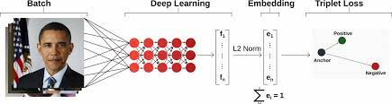
Algorithms
FaceNet model

Slide 9
FaceNet
FaceNet is a deep learning model designed for face recognition and facial feature embedding. It was introduced by researchers at Google in a paper titled "FaceNet: A Unified Embedding for Face Recognition and Clustering" by Florian Schroff, Dmitry Kalenichenko, and James Philbin, presented at CVPR 2015.

Slide 10
FaceNet Architecture
Inception Module:
FaceNet utilizes a modified version of the GoogLeNet architecture, particularly the Inception module, to extract features from face images.
Triplet Loss:
The innovation of FaceNet lies in its use of a triplet loss function. The network is trained to ensure that the Euclidean distance between the embeddings of anchor-positive pairs (images of the same person) is minimized, while the distance between anchor-negative pairs (images of different people) is maximized.

Slide 11
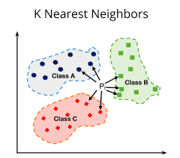
KNN Model
K-Nearest Neighbors (KNN) is a simple, yet powerful, supervised machine learning algorithm used for classification and regression tasks.
Instance Based Learning:
KNN is an instance based learning algorithm. It doesn't learn explicit models during the training phase but memorizes the entire training dataset.
2.Lazy Learning:
KNN is often considered a "lazy learner" because it defers the actual learning until a prediction needs to be made. The model doesn't generalize from the training data; instead, it uses the entire dataset for predictions.

Slide 12
KNN Model
Parameters:
K (Number of Neighbors):
The choice of 'K' is a crucial parameter. A smaller 'K' can make the model sensitive to noise, while a larger 'K' may smooth over important patterns.
Distance Metric:
The choice of distance metric depends on the nature of the data. Common options include Euclidean distance, Manhattan distance, or other custom metrics.

Slide 13
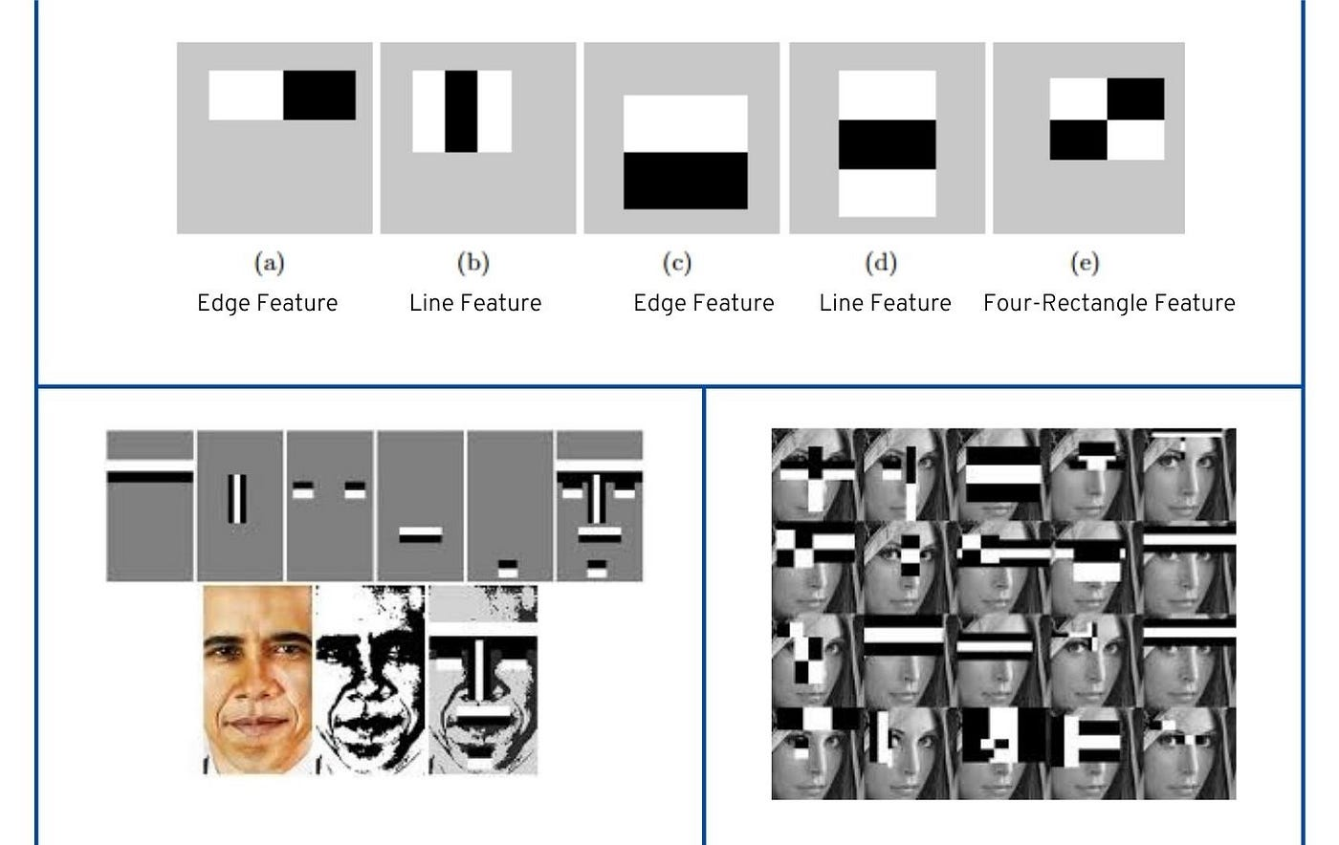
Haar Cascade Classifier
A Haar Cascade is a machine learning object detection method used to identify objects in images or video. It is particularly popular for face detection, although it can be trained to detect other objects as well. The Haar Cascade model was introduced by Viola and Jones in their paper "Rapid Object Detection using a Boosted Cascade of Simple Features" published in 2001.

Slide 14
Haar Cascade Classifier
There are three main types of Haar-like features:
Edge Features:
Edge features capture changes in intensity between adjacent rectangular regions. These features are sensitive to edges or transitions between light and dark areas.
Line Features:
Line features capture changes in intensity over a larger area than edge features. They are sensitive to the orientation of the lines in the image.
Four Rectangle Features:
Four-rectangle features divide the region into four subregions and compute the difference in intensity between the sum of pixels in the top-left and bottom-left rectangles and the sum of pixels in the top-right and bottom-right rectangles.

Slide 15
Architecture Of Project

Slide 16
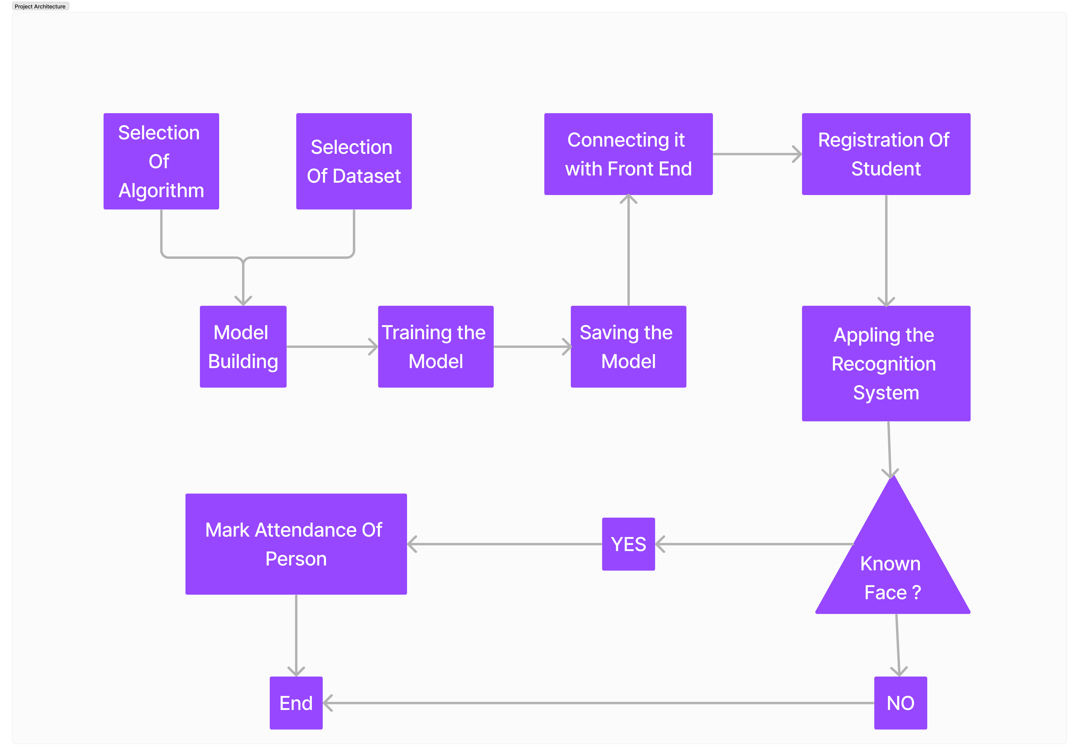

Slide 17
Guides Approval Mail screenshot
School of Computer Science and Engineering 23MCA1041

Slide 18
Thank You
School of Computer Science and Engineering 23MCS1004

